Slide 1



When Physicians Cannot
Connect the Dots
Building a Governed Healthcare Agent with IBM Bob
A practical case study on multi-agent orchestration, MCP integration, deterministic controls, and human oversight.
Monika Aggarwal
Enterprise AI and GTM leader, IBM
1
Notes:
This is not a talk about replacing physicians. It is about why agentic workflow design matters when patient context is fragmented across specialists, tests, messages, and follow-ups. Earlier this year, I experienced healthcare from the patient side. I was moving across multiple specialists, tests, medications, and follow-ups. Each person had part of the picture. The challenge was connecting it all.
That experience led me to a simple question: what would happen if we used an AI agent to help coordinate that journey?
So I built a healthcare agent with a PCP-style orchestrator, specialist agents, governed tool access, and clinician review.
The prototype worked quickly.
Then the more important problem appeared.
The agent looked active, but the workflow behavior was not always correct. It routed too early. It moved context too loosely. It made decisions without enough structure.
That is the focus of this session.
Not how to make an agent answer.
How to make an agent behave safely, predictably, and usefully inside a real healthcare workflow.
For executives, the takeaway is simple: the value of agentic AI will not come from more autonomy alone. It will come from combining reasoning with clear workflow boundaries, governed handoffs, controlled tool access, and human oversight.

Slide 2
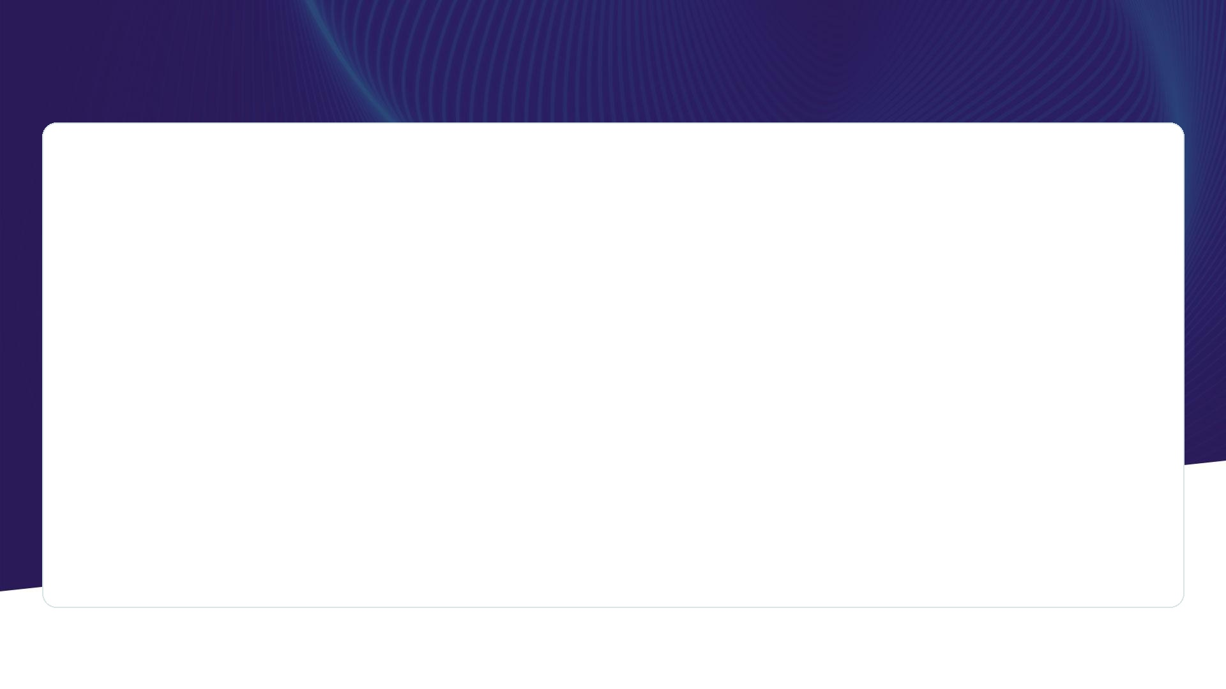
Core thesis
A busy agent can still be wrong
loose
autonomy
wrong
routing
weak
handoffs
Safe healthcare AI needs workflow and deterministic controls
governed
workflow
testable
behavior
human
review
Takeaway: Agent reasoning is useful only inside a designed care-navigation path.
2
Notes:
Set the frame early. The audience should remember this line: activity is not correctness. Routing is not reasoning.

Slide 3
The personal starting point
The patient often becomes the integration layer
Specialist A
Multiple specialists
Fragmented context
Who will connect the Dots?
Patient
Specialist B
Labs
The burden shifted to the patient:
what changed, who knew what, and what should happen next?
Messages
Design lens: support care navigation without pretending the agent is a physician.
3
Notes:
Tell this plainly. Do not share medical detail. The point is fragmented context and why PCP coordination matters.

Slide 4
Why did I choose this Use Case?
The story sits at the intersection of healthcare, enterprise AI, and product delivery
Healthcare delivery
AI-enabled clinical workflow and remote patient monitoring solutions
Enterprise AI
Agentic AI strategies, reusable architectures, and production-focus
Technical eminence
Co-hosts Agent Sense and creates 60 Seconds of Enterprise AI.
Hands-on build
Built and tested the PCP coordinator prototype with IBM Bob as a development partner.
The speaking value is the fit:
real problem + working prototype + production governance
4
Notes:
This is a credibility bridge, not a resume. Keep it short and tie each point back to why the audience should trust the lesson.

Slide 5
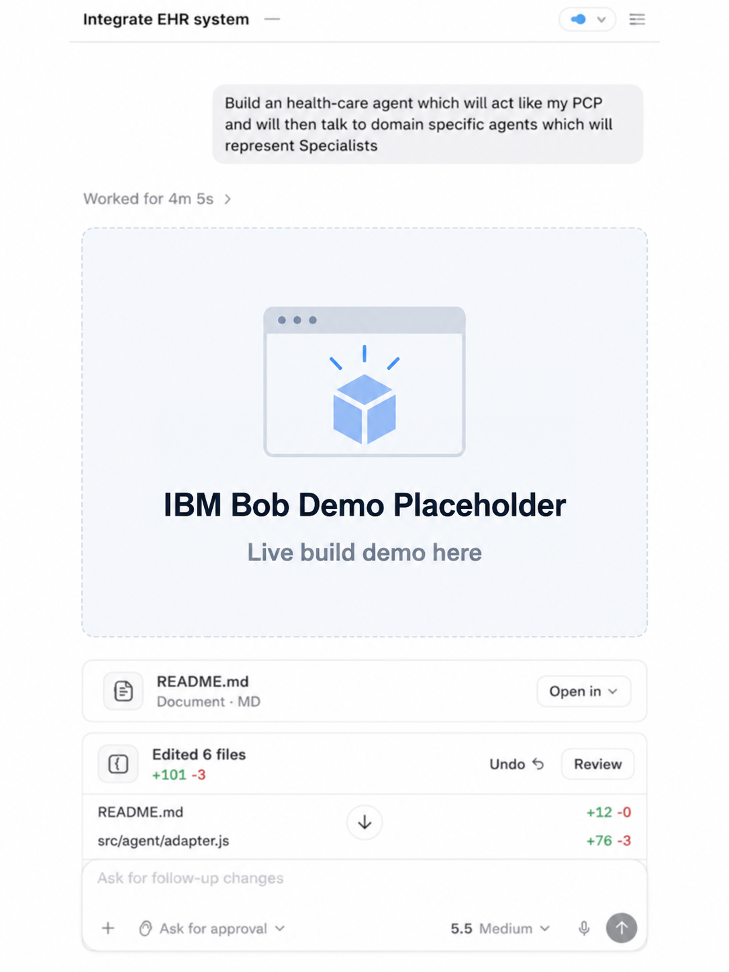
What I built with IBM Bob
A PCP coordinator agent with bounded specialist support agents
Reviews patient concerns and symptoms
Detects emergency warning phrases before normal routing
Coordinates specialty support agents
Produces clinician-ready summaries
Requires patient approval before sending messages
  Care navigation only
  • Gather context
  • Coordinate specialist input
  • Prepare clinician summary
  • Clinician makes the care decision
5
Notes:
Explain that IBM Bob helped accelerate the build and iteration. Be precise: Bob is the development partner used to build the prototype, not the clinician or production runtime.

Slide 6
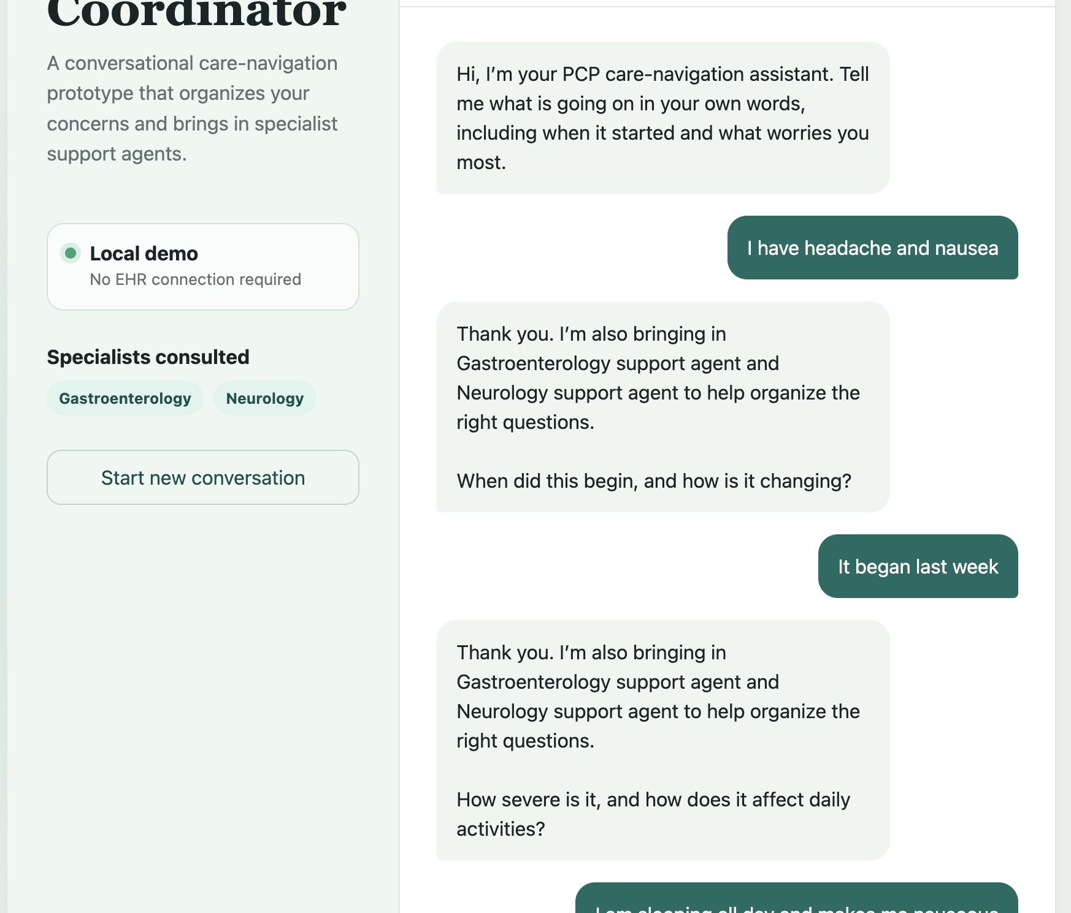
The Day 3 / Day 4 test
The demo worked. The workflow behavior exposed the risk.
Test input
“I have a headache and feel nauseous.”
What happened
The PCP agent repeatedly brought in Gastroenterology and Neurology support before enough intake context was captured.
The safety disclaimer was correct.
The workflow behavior was wrong.
6
Notes:
Use the screenshot to make the failure concrete. Do not over-medicalize. The failure is routing before adequate intake and context transfer.

Slide 7
The gap between routing and reasoning
The agent looked coordinated. The workflow did not prove understanding.
Neurology
Missing: structured intake before routing
user symptom
PCP
orchestrator
Missing: controlled handoff context
GI
Missing: deterministic next step
What should happen first
onset · severity · change · warning signs · required context
Observability shows what the agent actually did
Governance defines what the agent was allowed to do or what should happen next!
7
Notes:
This is the central critique. Loose routing is not a healthcare-only problem. It shows up anywhere the workflow has high impact.
Observability:
The trace shows that the PCP agent routed to Neurology and Gastroenterology.
Governance:
The workflow should require onset, severity, symptom change, warning signs, and enough context before routing.

Slide 8
Reference architecture
PCP orchestrator, bounded specialist agents, MCP gateway, systems of record, and clinician review
Neurology
EHR
PCP Agent
Orchestrator
intake · context
routing · summary
MCP
Gateway
auth · policy
routing · audit
Care navigation
chat
Labs
Patient
concern
GI
Care plan
Other
specialists
Medications
Clinician
review
Approved tools only.
Human review before high-impact action.
8
Notes:
This is a simple whiteboard version. Explain MCP as controlled tool access and routing, with enterprise governance around it.

Slide 9
Where MCP fits
MCP makes tool access explicit. Governance makes it safe.
A healthcare agent becomes risky when it can call tools, retrieve records, route work, or draft messages without a contract for what it can access and what must be reviewed.
MCP
contract
Agent
Approved
tools
Expose
approved tools and resources
identity, scopes, consent
Do not confuse a protocol with a governance program.
MCP is the contract. The enterprise still owns policy, approval, and audit.
Authorize
Observe
calls, parameters, failures
Block
unsafe or out-of-scope actions
9
Notes:
MCP is not a magic governance. It turns tools into an explicit contract, but enterprise policy and review still need to be designed.

Slide 10
The handoff contract
A specialist handoff should carry evidence, not assumptions
The orchestrator should not forward a vague symptom. It should pass a structured packet that explains why the specialist is needed and what context was used.
Before routing
Structured Handoff
symptom onset
severity and change
“headache + nausea”
→ route to two specialists
warning signs checked
reason for routing
handoff context
approval status
Contract rule:
if required context is missing, ask more questions before routing.
10
Notes:
Here I am showing the difference between loose routing and a governed handoff.
On the left, the PCP agent sees ‘headache and nausea’ and immediately routes to two specialists. That is activity, but it does not prove the agent understood the case.
The problem is that the handoff is missing structure. We do not know when the symptoms started, how severe they are, whether they are changing, whether warning signs were checked, or why each specialist is being involved.
So I introduced a handoff contract.
The contract defines the minimum context that must move with the case before routing happens.
That includes symptom onset, severity and change, warning-sign checks, the reason for routing, the context being handed off, and the approval state.
The important point is that the orchestrator cannot simply decide to send the case somewhere. It has to satisfy the handoff requirements first.
If required context is missing, the workflow asks more questions before routing.
This makes the handoff testable. We can verify what context was collected, why the specialist was selected, and exactly what information moved between agents.
That is the shift from a loose multi-agent conversation to a governed workflow.”

Slide 11
Test the trajectory, not only the final answer
The unit of safety is the path from intake to action
1
Intake fields
2
Escalation check
3
Routing rule
4
Handoff packet
5
Tool call
6
Clinician review
Expected path defined
Tool parameters validated
Trace captured
Failures classified
Behavior monitored
Regression risk comes from every change: model, agent role, policies, routing logic, or data source
11
Notes:
Treat this as a production lesson. Testing cannot start after the demo. The test strategy shapes the design. this path must also be testable over time. Every model, prompt, tool, policy, or routing change can alter behavior, so you need:
Expected path defined
Tool parameters validated
Trace captured
Failures classified
Behavior monitored

Slide 12
Human and agent decision rights
Clear boundaries prevent the agent from freelancing inside a regulated workflow
Agent can prepare
Human must approve
• organize symptoms
• diagnosis
• ask structured follow-ups
• treatment decision
• retrieve allowed context
• medication change
• draft summary
• urgent escalation decision
• suggest routing with evidence
• message sent to clinician or patient
In healthcare, the agent supports navigation. It does not become an autonomous clinical decision-maker.
12
Notes:
This slide protects the message. You are not claiming autonomous clinical care. You are making the case for governed care navigation.

Slide 13
From prototype to operational trust
Day 3 and Day 4 are where agentic AI earns the right to scale
Demo works
agents answer
tools connect
Workflow is testable
expected paths
controls defined
Workflow is governable
policy, access,
approval, trace
Workflow improves
monitoring and
regression loops
Production readiness means proving the workflow behaved safely, not proving the model produced a plausible answer.
13
Notes:
Connect this to executives and architects. The boring controls make the system scalable.

Slide 14
What attendees should take away
A reusable pattern for healthcare agents and other high-impact workflows
A healthcare agent becomes useful when it connects fragmented patient information into a longitudinal view, identifies what needs attention, and supports the right next action with clear human oversight
Design
Govern
Test
Start with the clinical workflow and expected outcome.
Define boundaries, approvals, routing rules, and tool access.
Validate the full path from intake to action after every change.
Seeded moderator questions: personal starting point, incorrect routing, deterministic controls, human review, and production readiness.
14
Notes:
This is the closing slide. Use it to land the answer to the summit follow-up question.

Slide 15
Backup: seeded questions
Use only if the moderator asks for them live
• What problem were you trying to solve with the healthcare agent?
• How did your patient experience shape the PCP orchestrator design?
• What did the incorrect routing teach you?
• Which workflow steps should be deterministic?
• Where does human review belong?
• What changes before this becomes production-ready?
15
Notes:
Optional backup slide. It can stay hidden or remain after the close.

